Slide 1


Telangana Growth analysis

Slide 2
STACKHOLDERS
Kalvakuntla Taraka Rama Rao (KTR)
Position: Minister for IT, Industries, and Municipal Administration
LinkedIn Profile: Link
Jayesh Ranjan
Position: Secretary, Information Technology (IT); Government of Telangana
LinkedIn Profile: Link
Dileep Konatham
Position: Director at Government of Telangana
LinkedIn Profile: Link
Venu Panjarla
Role: Open Data Telangana
LinkedIn Profile: Link

Slide 3
CODEBASICS TEAM
Dhaval Patel
Founder, Codebasics
LinkedIn Profile: Link
Hemanand Vadivel
Co-Founder, Codebasics
LinkedIn Profile: Link
I would like to express my gratitude to codebasics team and Government of Telangana
for providing this data set and the opportunity to grow and improve our skills. Thank You!

Slide 4
CONTENTS
ABOUT THE PROJECT
01
02
OBJECTIVE
03
PRELIMINARY INSIGHTS
04
SECONDARY INSIGHTS

Slide 5

ABOUT THE PROJECT
01
Telangana, a rapidly growing state in India with an open data policy, has made all its data accessible online. Analyzing Telangana's growth across various sectors quantitatively can yield valuable insights for the government. These insights can inform data-driven decisions to further boost the state's development..

Slide 6
OBJECTIVE
02
Explore Stamp Registration, Transportation and
Ts-Ipass Datasets. Understand their attributes, categories and time period.
Analyze trends and patterns within each department.
Identify growth opportunities and areas needing attention.
Find correlation among these departments and report the overall growth of the state through insights and relevant visuals such as shape maps.

Slide 7


03
PRELIMINARY INSIGHTS

Slide 8


STAMP REGISTRATION

Slide 9
VENUS
1. How does the revenue generated from document registration vary across districts in Telangana? List down the top 5 districts that showed the highest document registration revenue growth between FY 2019 and 2022.
Mulugu: This district achieved a remarkable 171% growth in document registration revenue, showcasing robust economic activity and property transactions.
Adilabad: Adilabad district recorded an impressive 123% growth in document registration revenue, indicating a thriving real estate market.

Slide 10
1. How does the revenue generated from document registration vary across districts in Telangana? List down the top 5 districts that showed the highest document registration revenue growth between FY 2019 and 2022.
VENUS
Mulugu: This district achieved a remarkable 171% growth in document registration revenue, showcasing robust economic activity and property transactions.
Adilabad: Adilabad district recorded an impressive 123% growth in document registration revenue, indicating a thriving real estate market.

Slide 11
VENUS
2.How does the revenue generated from document registration compare to the revenue generated from e-stamp challans across districts? List down the top 5 districts where e-stamps revenue contributes significantly more to the revenue than the documents in FY 2022?
Rangareddy: District leads in revenue generation, with approximately 37 billion from document registration and 38 billion from e-stamp challans, indicating a nearly equal contribution of both sources.
Medchal Malkajgiri: In this district, document registration revenue stands at around 24 billion, whereas e-stamp revenue closely follows at 23 billion, showcasing a balanced revenue distribution.

Slide 12
2.How does the revenue generated from document registration compare to the revenue generated from e-stamp challans across districts? List down the top 5 districts where e-stamps revenue contributes significantly more to the revenue than the documents in FY 2022?
VENUS
Rangareddy: District leads in revenue generation, with approximately 37 billion from document registration and 38 billion from e-stamp challans, indicating a nearly equal contribution of both sources.
Medchal Malkajgiri: In this district, document registration revenue stands at around 24 billion, whereas e-stamp revenue closely follows at 23 billion, showcasing a balanced revenue distribution.

Slide 13
VENUS
3. Is there any alteration of e-Stamp challan count and document registration count pattern since the implementation of e-Stamp challan? If so, what suggestions would you propose to the government?
The implementation of E-Stamp has shown promising growth, but Document Registration remains relevant.
A balanced approach, focusing on promoting E-Stamp while improving traditional registration processes, can ensure efficiency and revenue generation.

Slide 14
3. Is there any alteration of e-Stamp challan count and document registration count pattern since the implementation of e-Stamp challan? If so, what suggestions would you propose to the government?
VENUS
The implementation of E-Stamp has shown promising growth, but Document Registration remains relevant.
A balanced approach, focusing on promoting E-Stamp while improving traditional registration processes, can ensure efficiency and revenue generation.

Slide 15
Suggestion for Government
Promote E-Stamp Awareness: Continue efforts to raise awareness about E-Stamp among citizens, businesses, and legal entities. Provide educational campaigns and resources to facilitate the transition from traditional stamps to electronic stamps.
Streamline E-Stamp Processes: Ensure that the E-Stamp process is user-friendly, efficient, and accessible to all. Simplify the procedures for purchasing and using E-Stamps.
Legal Framework: Ensure that the legal framework governing electronic stamps is robust and up to date with technological advancements. This will build trust in E-Stamp systems.
User Support: Provide adequate support and customer service for users of both E-Stamp and Document Registration. Address any issues promptly to maintain public confidence.
Enhance Document Registration Procedures: While promoting E-Stamp, do not neglect traditional Document Registration. Modernize and digitize document registration processes to improve efficiency and reduce paperwork.

Slide 16
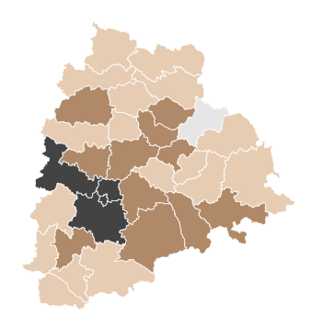
4. Categorize districts into three segments based on their stamp registration revenue generation during the fiscal year 2021 to 2022
District wise stamp registration fiscal year 2021 - 2022
Kumurambheem Asifabad: Lowest revenue - 15.04 M
Rangareddy : Highest revenue - 76 bn INR
High
Medium
Low

Slide 17
4. Categorize districts into three segments based on their stamp registration revenue generation during the fiscal year 2021 to 2022
District wise stamp registration fiscal year 2021 - 2022
Kumurambheem Asifabad: Lowest revenue - 15.04 M
Rangareddy : Highest revenue - 76 bn INR
High
Medium
Low

Slide 18
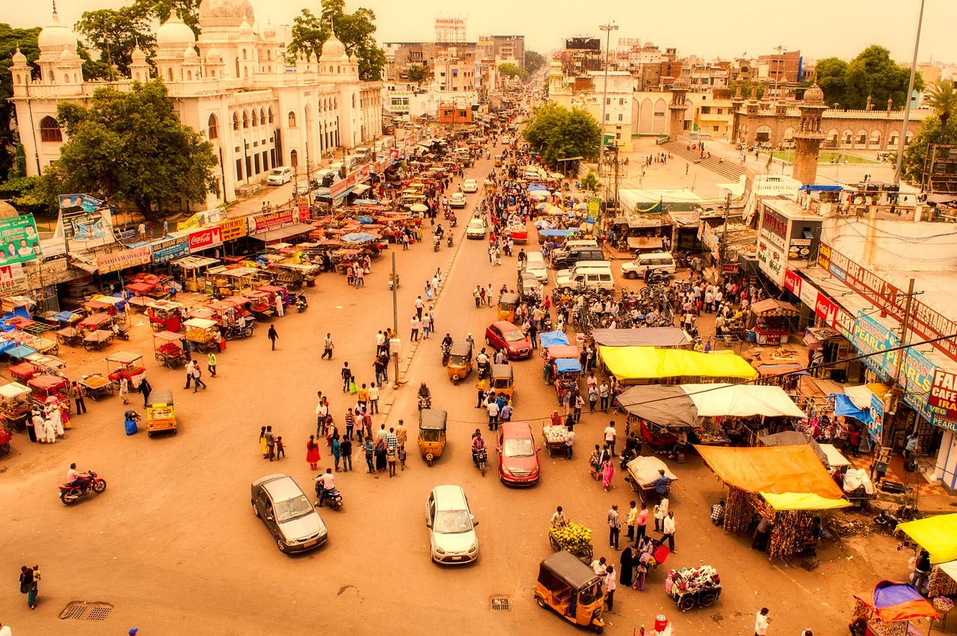
TRANSPORTAITON

Slide 19
5. Investigate whether there is any correlation between vehicle sales and specific months or seasons in different districts. Are there any months or seasons that consistently show higher or lower sales rate, and if yes, what could be the driving factors? (Consider Fuel-Type category only)
Overall Trends: February consistently records the lowest vehicle sales, with 66,431 units sold, while March consistently exhibits higher sales, reaching 151,416 units. This pattern can be attributed to various factors, including end-of-year promotions and tax incentives.

Slide 20
5. Investigate whether there is any correlation between vehicle sales and specific months or seasons in different districts. Are there any months or seasons that consistently show higher or lower sales rate, and if yes, what could be the driving factors? (Consider Fuel-Type category only)
Overall Trends: February consistently records the lowest vehicle sales, with 66,431 units sold, while March consistently exhibits higher sales, reaching 151,416 units. This pattern can be attributed to various factors, including end-of-year promotions and tax incentives.

Slide 21
District-wise Trends
Kamareddy
This district experiences the lowest sales in December, with 898 units, and the highest in May, with 2,590 units. Seasonal factors like climate and agricultural activities might influence these trends.
Karimnagar
February marks the lowest sales in Karimnagar, with 1,309 units, while May sees the highest sales at 4,867 units. This could be linked to better weather conditions for vehicle purchases and travel during May.
Kumurambheem Asifabad
December reports the lowest sales in this district, with 333 units, while March records the highest sales at 1,405 units. Agricultural activities during these months may affect vehicle demand.
Hanumakonda and Mulugu
Notably, there were no vehicle sales recorded in Hanumakonda and Mulugu during the observed period. This could be due to various factors, including limited economic activity or data collection issues.

Slide 22
6. How does the distribution of vehicles vary by vehicle class (MotorCycle, MotorCar, AutoRickshaw, Agriculture) across different districts? Are there any districts with a predominant preference for a specific vehicle class? Consider FY 2022 for analysis.
Motorcycle Dominance: Across all districts, motorcycles are the predominant vehicle class, indicating a common preference for two-wheelers in the region.
Hyderabad: While Hyderabad has the highest overall vehicle sales at 282,122 units, it notably records only 20 agriculture vehicle sales, suggesting a strong urban vehicle market.
Kumurambheem Asifabad: This district reports agriculture vehicle sales of approximately 160 units, demonstrating a presence of agricultural activity in the region.

Slide 23
6. How does the distribution of vehicles vary by vehicle class (MotorCycle, MotorCar, AutoRickshaw, Agriculture) across different districts? Are there any districts with a predominant preference for a specific vehicle class? Consider FY 2022 for analysis.
Motorcycle Dominance: Across all districts, motorcycles are the predominant vehicle class, indicating a common preference for two-wheelers in the region.
Hyderabad: While Hyderabad has the highest overall vehicle sales at 282,122 units, it notably records only 20 agriculture vehicle sales, suggesting a strong urban vehicle market.
Kumurambheem Asifabad: This district reports agriculture vehicle sales of approximately 160 units, demonstrating a presence of agricultural activity in the region.

Slide 24
7. List down the top 3 and bottom 3 districts that have shown the highest and lowest vehicle sales growth during FY 2022 compared to FY 2021? (Consider and compare categories: Petrol, Diesel and Electric)

Slide 25
7. List down the top 3 and bottom 3 districts that have shown the highest and lowest vehicle sales growth during FY 2022 compared to FY 2021? (Consider and compare categories: Petrol, Diesel and Electric)

Slide 26
62.53K
Sales growth during FY 2022 compared to FY 2021
Sales – FY 2022
Growth
ELECTRIC
101%
DIESEL
196.1K
-1.63%
PETROL
-14%
1.14M

Slide 27

Ts-Ipass Telangana State Industrial Project Approval and Self Certification System

Slide 28
Takeaway
These investments signify a diversified economic landscape in FY 2022, with a significant emphasis on industries such as plastics, pharmaceuticals, real estate, renewable energy, and engineering. These sectors play a crucial role in driving economic growth and development in the region.
8. List down the top 5 sectors that have witnessed the most significant investments in FY 2022

Slide 29
8. List down the top 5 sectors that have witnessed the most significant investments in FY 2022
Takeaway
These investments signify a diversified economic landscape in FY 2022, with a significant emphasis on industries such as plastics, pharmaceuticals, real estate, renewable energy, and engineering. These sectors play a crucial role in driving economic growth and development in the region.

Slide 30
Proximity to Hyderabad: All three districts are in close proximity to Hyderabad, the state capital and an economic hub. This proximity provides access to a skilled workforce, infrastructure, and market opportunities, making them favorable locations for investments.
Industrial Infrastructure: These districts have developed industrial parks, technology zones, and IT clusters, creating an enabling environment for businesses to thrive.
Government Policies: The government's pro-business policies, investment incentives, and ease of doing business initiatives have encouraged companies to invest in these districts.
Connectivity: Good transportation networks and connectivity to major cities and ports enhance the attractiveness of these districts for logistics and manufacturing companies.
Economic Diversification: The districts have diversified economies, with a focus on sectors like IT, manufacturing, real estate, and pharmaceuticals, attracting a wide range of investments.
.
9. List down the top 3 districts that have attracted the most significant sector investments during FY 2019 to 2022? What factors could have led to the substantial investments in these particular districts?

Slide 31
9. List down the top 3 districts that have attracted the most significant sector investments during FY 2019 to 2022? What factors could have led to the substantial investments in these particular districts?
Proximity to Hyderabad: All three districts are in close proximity to Hyderabad, the state capital and an economic hub. This proximity provides access to a skilled workforce, infrastructure, and market opportunities, making them favorable locations for investments.
Industrial Infrastructure: These districts have developed industrial parks, technology zones, and IT clusters, creating an enabling environment for businesses to thrive.
Government Policies: The government's pro-business policies, investment incentives, and ease of doing business initiatives have encouraged companies to invest in these districts.
Connectivity: Good transportation networks and connectivity to major cities and ports enhance the attractiveness of these districts for logistics and manufacturing companies.
Economic Diversification: The districts have diversified economies, with a focus on sectors like IT, manufacturing, real estate, and pharmaceuticals, attracting a wide range of investments.
.

Slide 32
10. Is there any relationship between district investments, vehicles sales and stamps revenue within the same district between FY 2021 and 2022?
District Investment and Stamp Revenue
A linear relationship is observed between district investments and stamp revenue. As investments in a district increase, stamp revenue also tends to increase. This suggests that economic activity and investments have a positive impact on stamp revenue generation.

Slide 33
10. Is there any relationship between district investments, vehicles sales and stamps revenue within the same district between FY 2021 and 2022?
District Investment and Stamp Revenue
A linear relationship is observed between district investments and stamp revenue. As investments in a district increase, stamp revenue also tends to increase. This suggests that economic activity and investments have a positive impact on stamp revenue generation.

Slide 34
10. Is there any relationship between district investments, vehicles sales and stamps revenue within the same district between FY 2021 and 2022?
District Investment and Vehicle Sales: While there may be some correlation between district investments and vehicle sales, it's not necessarily a linear relationship. Other factors like consumer preferences, infrastructure development, and economic conditions can also influence vehicle sales.
In the case of Hyderabad, although it has lower investments compared to some other districts, it may have higher vehicle sales due to various factors such as a larger population, urbanization, higher income levels, and a more developed transportation infrastructure. These factors can contribute to increased vehicle demand and sales.

Slide 35
10. Is there any relationship between district investments, vehicles sales and stamps revenue within the same district between FY 2021 and 2022?
District Investment and Vehicle Sales: While there may be some correlation between district investments and vehicle sales, it's not necessarily a linear relationship. Other factors like consumer preferences, infrastructure development, and economic conditions can also influence vehicle sales.
In the case of Hyderabad, although it has lower investments compared to some other districts, it may have higher vehicle sales due to various factors such as a larger population, urbanization, higher income levels, and a more developed transportation infrastructure. These factors can contribute to increased vehicle demand and sales.

Slide 36
Note :
Performing additional statistical analysis is crucial to accurately quantify and validate these relationships. It's vital to acknowledge that each district possesses distinct economic and demographic characteristics that can influence the connections between investments, vehicle sales, and stamp revenue. Hence, a comprehensive analysis, incorporating statistical modeling, becomes imperative to gain a deeper understanding of these relationships and pinpoint the unique drivers in each district.
This initial observation underscores the necessity for a nuanced, data-driven approach to economic analysis and policymaking.

Slide 37
11. Are there any particular sectors that have shown substantial investment in multiple districts between FY 2021 and 2022?

Slide 38
11. Are there any particular sectors that have shown substantial investment in multiple districts between FY 2021 and 2022?

Slide 39
Pharmaceuticals and Chemicals:
This sector has shown significant investments in Rangareddy, Sangareddy, Medchal Malkajgiri, Medak, and Mahabubnagar districts, indicating its prominence and potential for growth.
Engineering:
Investments in the Engineering sector have been substantial in Rangareddy, Sangareddy, Medchal Malkajgiri, Medak, and Mahabubnagar districts, reflecting a strong focus on infrastructure and technological advancements.
Granit and Stone Crushing:
The Granit and Stone Crushing sector has garnered notable investments in Rangareddy, Sangareddy, Medchal Malkajgiri, Medak, and Mahabubnagar districts, suggesting demand for construction materials.
Food Processing Agro-Based:
Investments in Food Processing Agro-Based industries, including Cold Storage, have been significant in Rangareddy, Sangareddy, Medchal Malkajgiri, Medak, and Mahabubnagar districts, emphasizing the importance of agriculture and food processing.
Real Estate, Industrial Parks, and IT Building:
Notably, this sector has primarily attracted investments in Rangareddy district, indicating a concentration of real estate and IT development in that area.

Slide 40
12. Can we identify any seasonal patterns or cyclicality in the investment trends for specific sectors? Do certain sectors experience higher investments during particular months?
Overall Sector Investments:
May records the lowest overall sector investments at 1,842.50 Crores, while August stands out with the highest investments at 5,102.22 Crores. This suggests a potential seasonal trend of higher investments during the summer months..

Slide 41
12. Can we identify any seasonal patterns or cyclicality in the investment trends for specific sectors? Do certain sectors experience higher investments during particular months?
Overall Sector Investments:
May records the lowest overall sector investments at 1,842.50 Crores, while August stands out with the highest investments at 5,102.22 Crores. This suggests a potential seasonal trend of higher investments during the summer months..

Slide 42
Agro-Based and Cold Storage
The Agro-Based sector, specifically Cold Storage, experiences its highest investments in June at 574.77 Crores, which aligns with the agricultural harvest season.
Automobile Sector:
While the automobile sector exhibits lower investments during certain months, it sees a surge in October, reaching 219.89 Crores, possibly due to new vehicle models or promotions.
Cement and Concrete,
Fly Ash Bricks: Investments in these sectors peak in August, totaling 966.82 Crores, indicating a potential construction-related seasonal trend.
Electric and Electronic
Products: This sector records its highest investments in July at 155.86 Crores, possibly linked to consumer electronics demand.
Engineering Sector:
Investments in the engineering sector are notably higher in February at 827.13 Crores, suggesting a potential focus on infrastructure and development during this period.
Paper and Printing:
The Paper and Printing sector sees significant investments in July, totaling 1,058.67 Crores, possibly related to publishing and packaging needs.
Real Estate, Industrial Parks, and IT Buildings:
This sector experiences substantial investments in March, amounting to 1,862.96 Crores, indicating a potential pattern related to fiscal year-end planning.
Solar and Other Renewable Energy:
Investments in this sector are highest in April, reaching 857.19 Crores, possibly linked to renewable energy project launches.

Slide 43
04
SECONDARY INSIGHTS

Slide 44

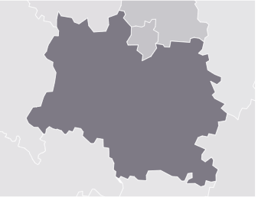
Top 5 districts to buy commercial properties in Telangana
Hyderabad
Rangareddy
Justification: As the capital and economic hub of Telangana, Hyderabad offers the most significant opportunities for commercial property investment. It has a robust IT sector, a growing startup ecosystem, and a diverse economy. The city's connectivity, business-friendly policies, and availability of skilled talent make it a prime choice for investors.
Justification: Rangareddy, adjacent to Hyderabad, benefits from the capital's economic spill-over. It has witnessed significant industrial and infrastructure development, making it an attractive location for businesses. Proximity to Hyderabad and its well-developed transportation networks enhance its commercial appeal.

Slide 45
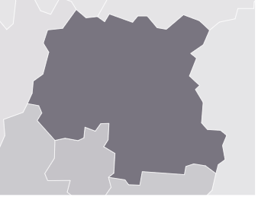

Medchal Malkajgiri
Sangareddy
Justification: This district has shown considerable growth in recent years, partly due to its proximity to Hyderabad and the presence of industrial zones. It offers a strategic location for businesses looking to serve both urban and suburban markets.
Justification: Sangareddy's strategic location and connectivity to Hyderabad make it an emerging commercial hub. It has seen notable investments in infrastructure, making it an appealing choice for businesses seeking expansion opportunities.

Slide 46
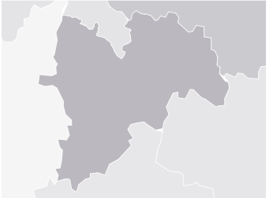
Mahabubnagar
Justification: Mahabubnagar is gaining prominence due to its potential for industrial growth and the development of industrial corridors. Its strategic location, coupled with government incentives, could attract businesses looking for cost-effective commercial properties.
It's important to note that the suitability of a district for commercial property investment may also depend on the specific needs and objectives of the investor. Factors like budget, industry sector, and long-term growth prospects should be considered when making an investment decision. Consulting with real estate experts and conducting thorough due diligence is advisable before making any commercial property investment.

Slide 47
What significant policies or initiatives were put into effect to enhance economic growth, investments, and employment in Telangana by the current government? Can we quantify the impact of these policies using available data?
Industrial Policy (TS-iPASS)
T-Hub (Innovation Ecosystem)
Rural Employment Generation Programmes (Rural Jobs)
Mission Kakatiya (Revival of Tanks)

Slide 48
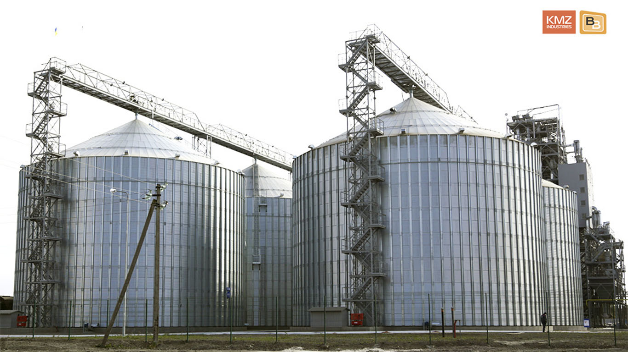
Industrial Policy (TS-iPASS)
Initiative
TS-iPASS is a comprehensive industrial policy that aims to provide a hassle-free business environment, expedited approvals, and single-window clearances for industries.
Potential Impact
By streamlining the approval process, this policy can attract investments and promote economic growth. The number of new industries established and the jobs created can be key indicators of its impact.

Slide 49
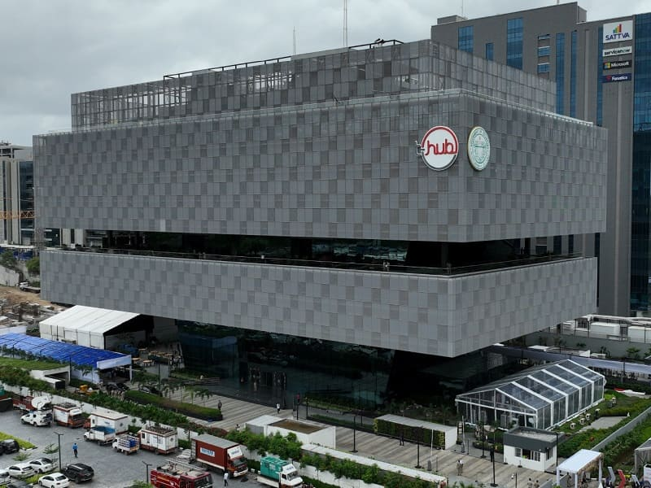
T-Hub (Innovation Ecosystem)
Initiative
T-Hub is a startup incubator and innovation hub that supports and nurtures entrepreneurial talent.
Potential Impact
The number of startups incubated, funding received by startups, and the growth of the startup ecosystem can measure the impact of this initiative on employment and economic growth.

Slide 50
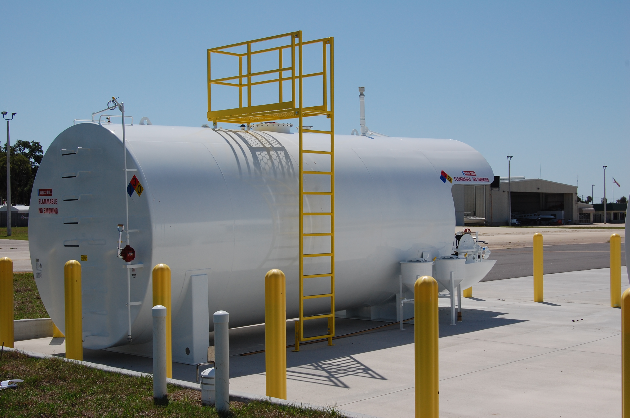
Mission Kakatiya (Revival of Tanks)
Initiative
Mission Kakatiya focuses on the restoration of tanks and water bodies, with an aim to improve agricultural productivity and create rural employment.
Potential Impact
The increase in the number of revived tanks, improved agricultural outcomes, and the number of rural jobs created can be used to quantify the impact.

Slide 51

Rural Employment Generation Programmes (Rural Jobs)
Initiative
Various rural employment generation programs aim to create jobs in rural areas through infrastructure development, watershed management, and skill training.
Potential Impact
The number of jobs created in rural areas and the improvement in rural living standards can be indicators of these programs' success.

Slide 52
Top 5 Insights & 5 recommendations to Telangana government for sustained growth in the next 5 years based on analysis.

Slide 53



TOP 5 INSIGHTS
Leverage the Tech Ecosystem
Invest in Infrastructure
Focus on Skilling and Education
Telangana's strong information technology ecosystem, centered around Hyderabad, should be leveraged further. Encourage innovation, support startups, and attract tech giants to foster economic growth.
Continued investment in infrastructure, particularly in transportation and digital connectivity, is essential for sustained growth. Improving connectivity between urban and rural areas can bridge economic disparities.
Prioritize skill development and education to ensure a skilled workforce that can meet the evolving demands of industries. Strengthening vocational training and STEM education can be beneficial.

Slide 54


TOP 5 INSIGHTS
Sustainable Agriculture
Diversify Industries
Develop sustainable agriculture practices to enhance food security and income in rural areas. Initiatives like Mission Kakatiya can be expanded to improve water management.
While technology is a strength, diversifying industries beyond IT, such as manufacturing and renewable energy, can create a more resilient economy.

Slide 55



TOP 5 RECOMMENDATIONS
Invest in Rural Development
Ease of Doing Business
Support Innovation
Develop and implement a comprehensive rural development strategy that includes infrastructure improvement, access to healthcare, and quality education to bridge the urban-rural divide.
Continue efforts to streamline regulatory processes and enhance the ease of doing business. Ensure that policies like TS-iPASS are effectively implemented.
Foster a culture of innovation by providing incentives, resources, and incubation facilities for startups and research institutions. Encourage public-private partnerships for innovation.

Slide 56


TOP 5 RECOMMENDATIONS
Sustainable Growth
Skilling and Workforce Development
Prioritize sustainable and eco-friendly practices, particularly in industries like agriculture and renewable energy. Develop incentives for environmentally responsible practices.
Establish partnerships with industries to design training programs that align with job market demands. Promote lifelong learning and upskilling among the workforce.

Slide 57

THANKS
Does anyone have any questions?
Follow the project updates
danasekar500@gmail.com
+91 9080379647
Linkedin profile

